Slide 1

Abstract Video Compression
By Milan Mauck

Slide 2
What are we trying to solve?
I am trying to compress a video stream down to something incredibly small, 1 - 2 kb/s.
The use case is for long range, low altitude drones, which almost always operate on low power and frequency and thus have very low bandwidth to stream video. We’re talking 3 kb/s or less.
The video stream needs only to convey the basic idea. Making out large distinct objects is the requirement, so as to fly and avoid them.

Slide 3
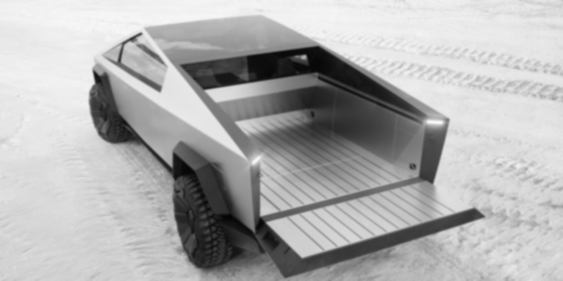
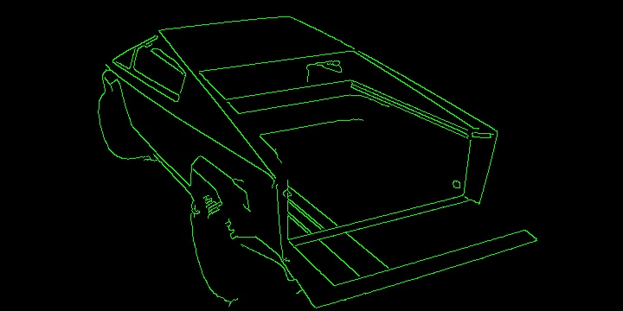
What are the steps?
Change the image to black and white and smooth with a Gaussian filter. Edge detection functions are very susceptible to noise I found out after much trial and error.
OpenCV to find edges in the image. I’m using cv2.Canny after poor results from other functions.

Slide 4
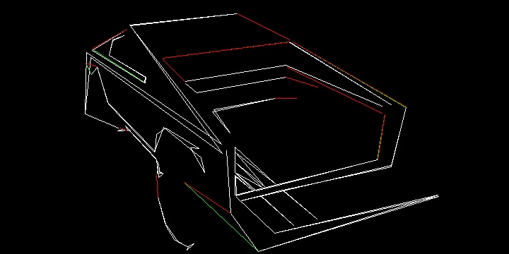
What are the steps?
Build contours from the edges from the previous step. Throw out the small contours, since they’re too small of detail to be worth drawing.
Approximate contours into shapes with straight lines.

Slide 5
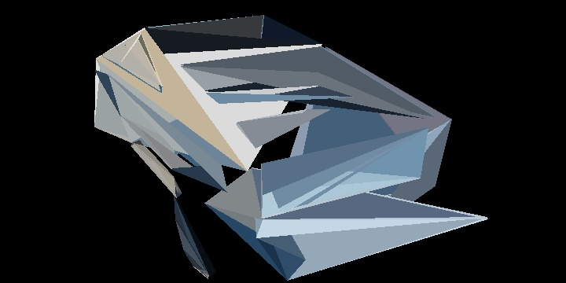
What are the steps?
Take the points from these approximated contours and turn into a bunch of triangles. This step is the hardest and tends to take the longest to process.
Extract the color from each triangle area in the original image and set as the color for the whole triangle for the output image.

Slide 6
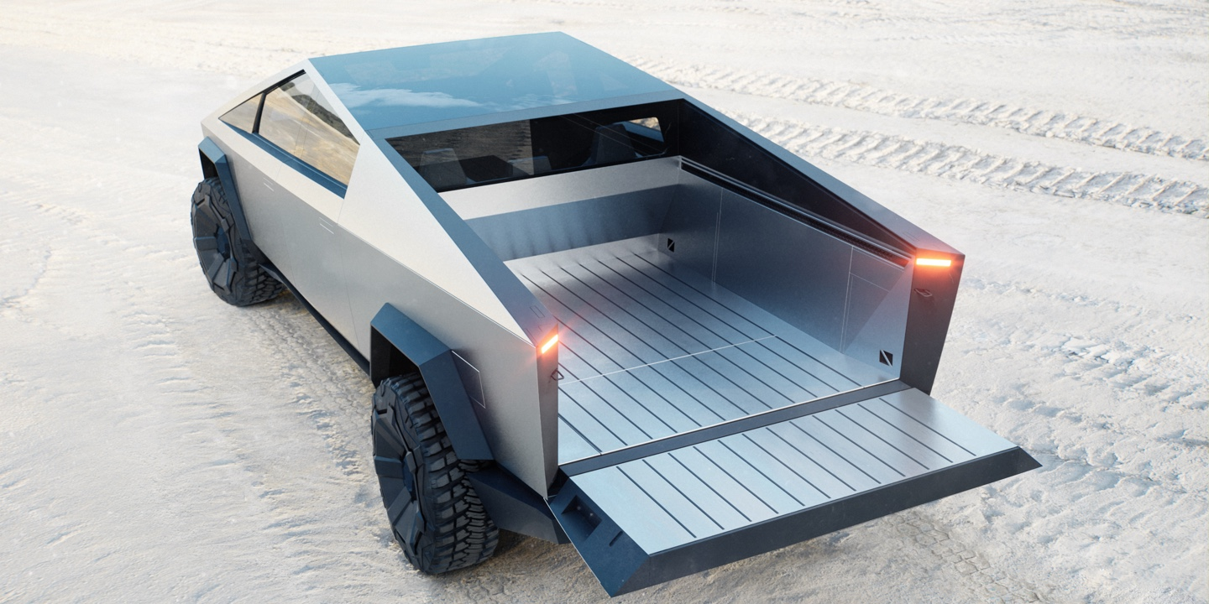
How much compression are we getting?
We’d be streaming the triangles as bytes, 1 byte for color, 12 bytes for the triangle’s 3 points, each point 2 short ints, 4 bytes.
The original image on the left is 344 KB, and the image on the right is <100 triangles, or 1.3KB worth of data.

Slide 7
Evaluation
It works! It was an ambitious idea for me with my limited experience.
Compression is good, but...
Needs a better way to sort which triangles are important to the image, rather than just big ones are more important.
Needs to reduce the overlap of triangles.
Needs further optimization to make it real time.

